Slide 1





BUILD EASE

Slide 2

Our Team
AYAZ HASAN
20K-1044
Group Leader
HUSSAIN TAHIR
20K-0185
SYED ARSALAN
20K-1718

Slide 3






TABLE OF CONTENT
01 Problem Statement
04 Features
02 Motivation
05 Architectural Diagram
03 Objectives
06 Milestone

Slide 4

PROBLEM STATEMENT
The construction industry is a very complex industry that is facing some problems :
Lack of Information of Private Contractors.
Determine the contractors and companies with bad reputation.
Lack of communication.
Quality of Materials

Slide 5
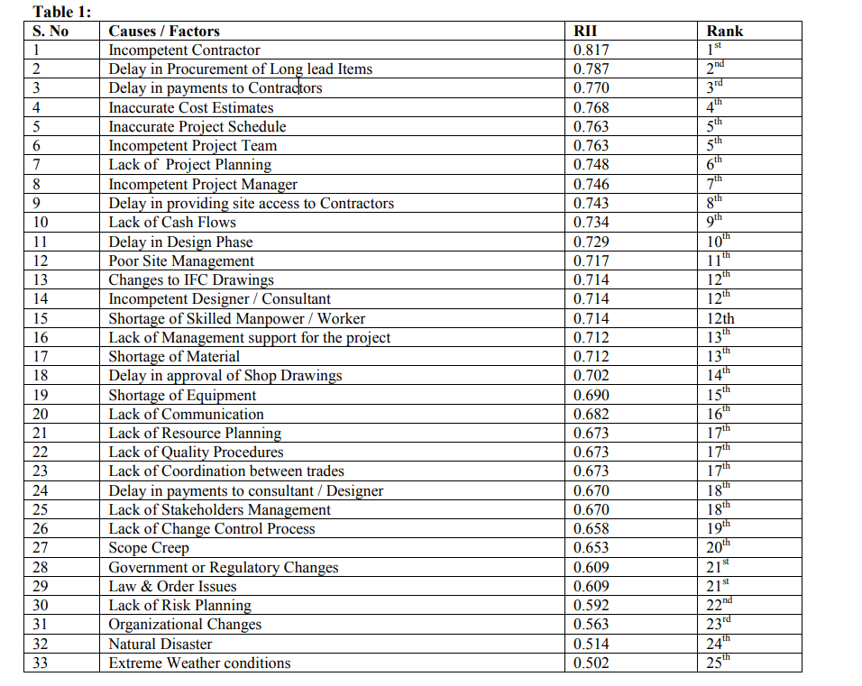

MOTIVATION
The motivation behind this project is to combine the services widely used in the industry and make them available on a single platform, which are available but on separate platforms and with no communication channel between the client and the service providers. This will enhance the efficiency and productivity of the work done in the industry.
Wasim, S. S. (2018). Causes of construction project failures in Pakistan. Wasim | Civil and Environmental Research. https://www.iiste.org/Journals/index.php/CER/article/view/43665

Slide 6
OBJECTIVES
Develop a mobile app for efficient project management in construction.
Connect users with construction companies, track projects, and manage budgets.
Enhance communication, reduce errors, and improve collaboration.
Boost construction industry productivity.
Provide access to valuable construction resources.
Continuously improve the app based on user feedback.

Slide 7
FEATURES
● User registration and authentication
● User profiles
● Company and provider profiles
● Company and provider discovery
● Recommender system
● Review and rating system
● Bulk purchase
● Materials catalog
● Local contractor search
● Cost estimation tool

Slide 8








Tools And Technologies
React Native

Slide 9
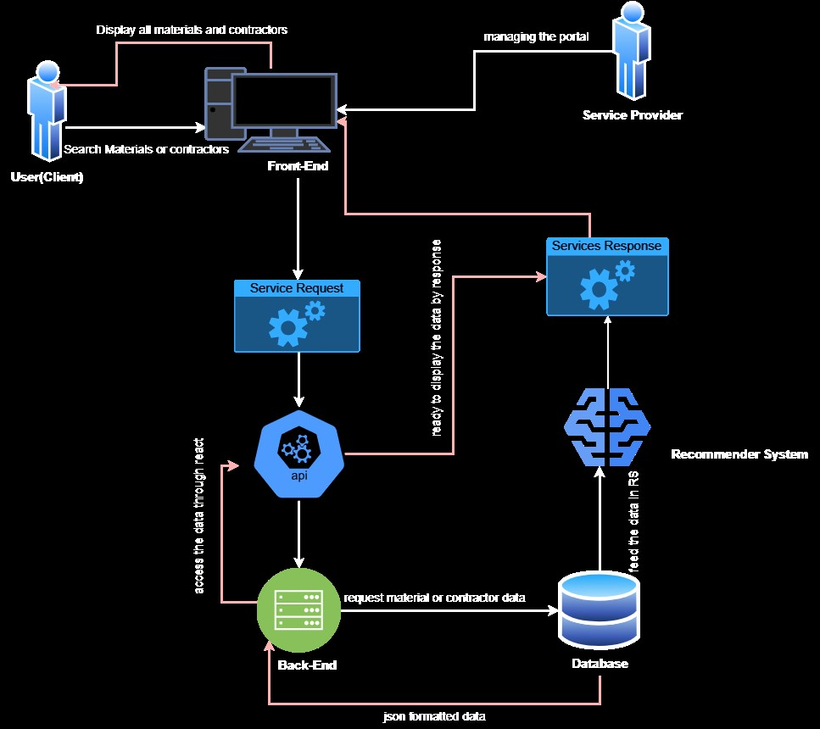
ARCHITECTURE

Slide 10
Project Timeline
MONTH 1
MONTH 2
MONTH 3
MONTH 4
MONTH 5
MONTH 6
MONTH 7
MONTH 8
UI DESIGN
CODING
TESTING
INTEGRATION
SYSTEM ANALYSIS
DATABASE DESIGN
PROJECT FINALIZATION
Gathering Software Resources and Information

Slide 11


THANK YOU
For watching this presentation
K201044@NU.EDU.PK
FAST NUCES, KARACHI

